Slide 1


Project Title: Smart Surveillance System (SSS)

Slide 2
Team
Abdullah Basit | 20I-0623
Muhammad Abubakar Siddique | 20F-0101
Supervisor
Dr. Usman Ghous

Slide 3
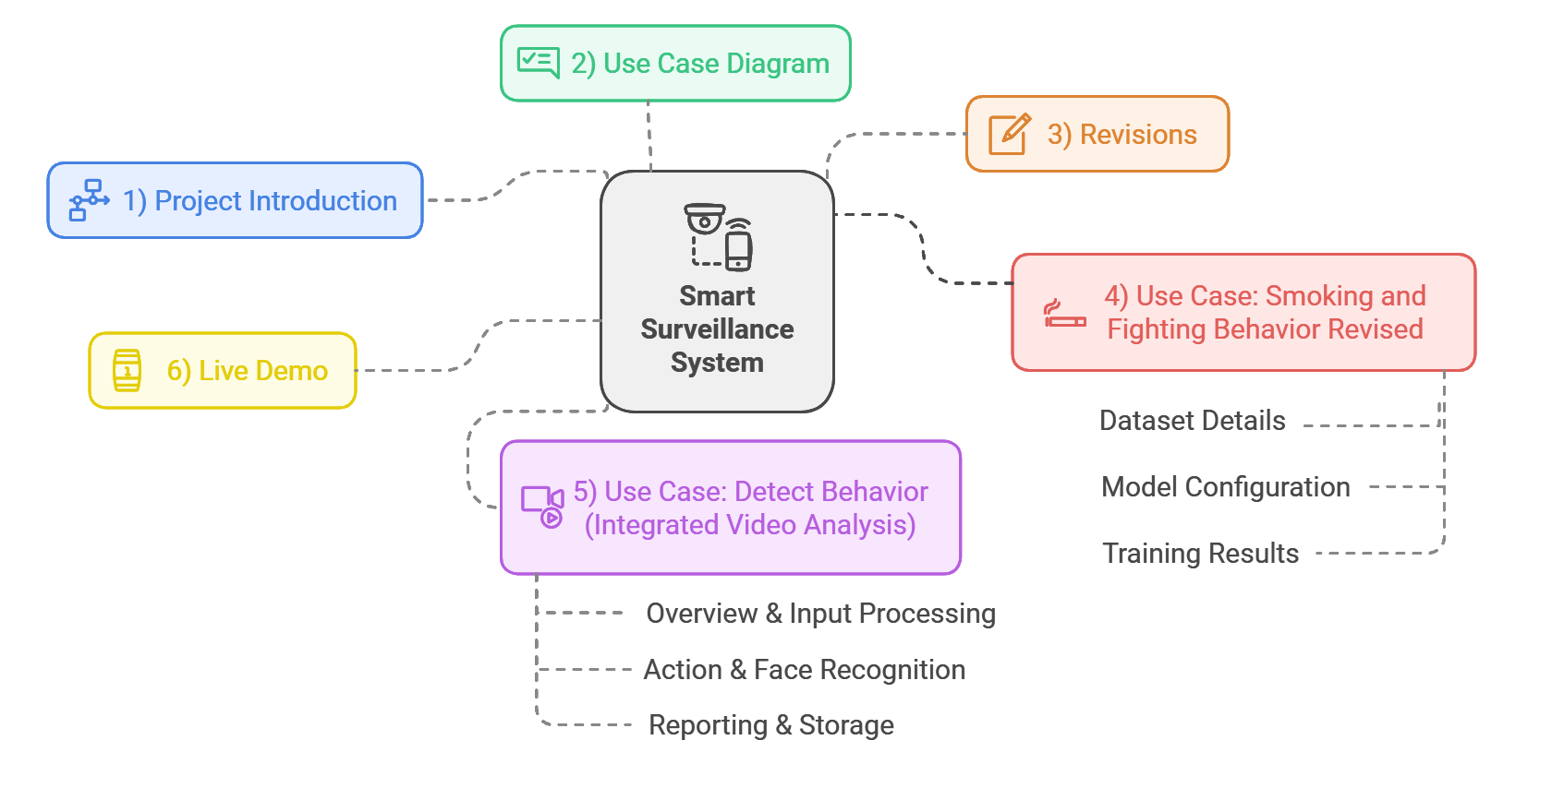
Outline

Slide 4
Project Introduction
SSS is a pioneering solution addressing surveillance gaps in university CCTV systems. It integrates facial recognition, computer vision, and behavior analysis for comprehensive monitoring. By proactively identifying and tracking specific behaviors, such as smoking or fighting, it overcomes human limitations in overseeing multiple cameras, ensuring continuous monitoring and precise risk management.

Slide 5
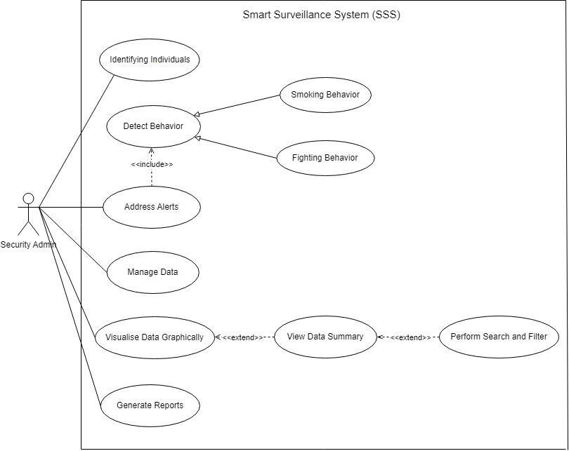
Use Case Diagram
Notes:
Generalization: smoking behavior (child inherits) and adds to parent detect behavior
Include: included use case detect behavior never stands alone, it occurs because address alert is a greater significant use case
Extend: base can stand alone (view data) but extension can be done on its behavior under certain conditions by another use case (search and filter)

Slide 6
Revisions
New Detection Model
Problem: 1- Old model cannot be converted to real time application 2- After action detection, facial recognition module could not identify the actual person of interest.
Solution: Spatio Temporal Action Detection model that introduces bounding boxes around individuals performing specific behaviors.
Dataset: Balanced dataset with 54 videos for Smoking and 54 for Fighting.
Evaluation Metric: Mean Average Precision (mAP)
Notes:
spatial (frame-by-frame) and temporal (time-based) information to localize and classify activities.
2. How many layers are in ResNet3D Backbone, and what are their purposes?
ResNet3D has multiple layers structured as follows:
Conv1: Extracts basic features (edges, textures) from video frames.
Res2, Res3, Res4, Res5 (Residual Blocks):
Gradually extract complex spatial-temporal patterns.
Deeper layers capture higher-level semantic information.
Fully Connected Layer: Maps features to classification or detection outputs.
FastRCNN: A region-based convolutional neural network that detects objects by extracting regions of interest (ROI) and classifying them.mmaction.ResNet3dSlowFast:SlowFast: A model with two streams: Slow stream (captures detailed spatial info) and Fast stream (focuses on temporal motion).
mAP Evaluates the intersection-over-union (IoU) between predicted and ground-truth bounding boxes

Slide 7
Use Case: Smoking and Fighting Behavior Revised

Slide 8
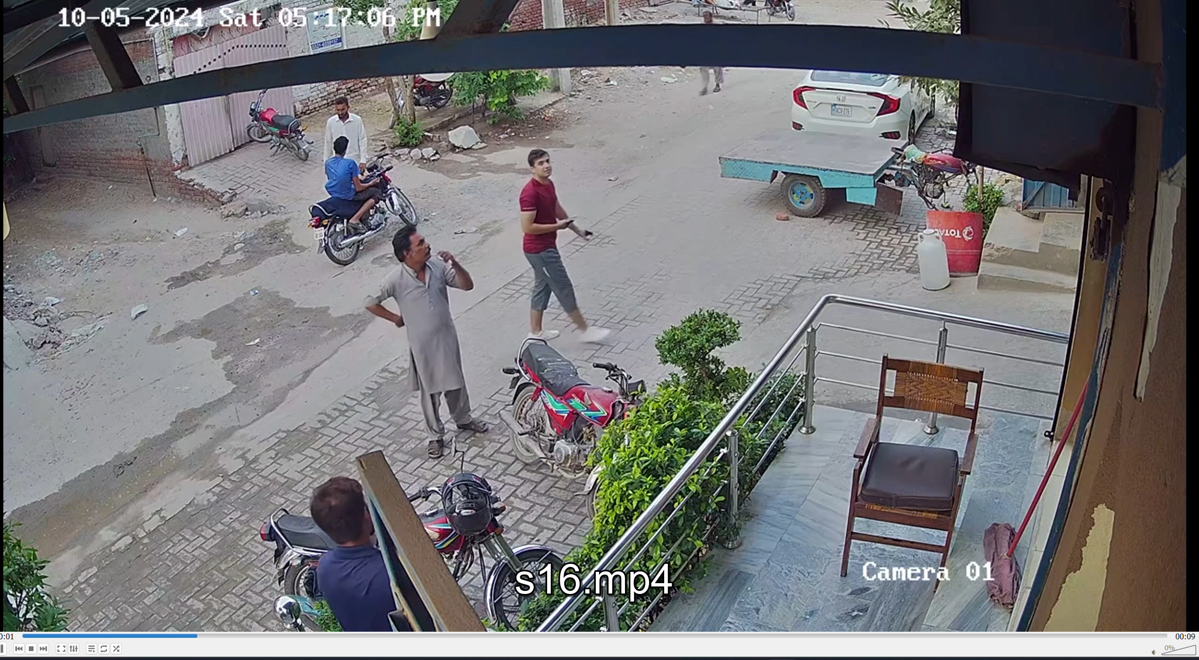
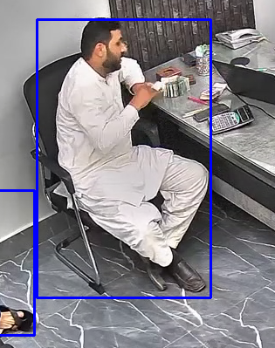
Dataset Details
Created a dataset of 2 classes: Custom Smoking and Fighting (108 Videos, 54 Each)
Data split into training (90 videos, 45 each) and validation (18 videos, 9 each) sets for model training.
All Data consisted of CCTV footages.
Annotated using CVAT

Slide 9
Model Configuration
FastRCNN withResNet3dSlowFast backbone, optimized for spatiotemporal action detection in videos on custom dataset.
Froze the first two layers to focus on task specific features and maintain general patterns.
Dataset based on AVADATASET format, provided by Google.
Training Pipeline includes multiple data augmentation techniques such as Random Rescaling, Cropping, Color Jitter, and Fixed Resize.
Used AdamW as optimizer.
Loss Function used to focus more on smoking class.
Evaluator based on AVAMetric: Mean Average Precision mAP score.
Initial Learning Rate: 0.00001
Warm-Up Phase: Gradual increase to 0.0001 over 5 epochs.
Cosine Annealing Decay: Begins at epoch 5, gradually decays towards 0.000001
Notes:
spatial (frame-by-frame) and temporal (time-based) information to localize and classify activities.
2. How many layers are in ResNet3D Backbone, and what are their purposes?
ResNet3D has multiple layers structured as follows:
Conv1: Extracts basic features (edges, textures) from video frames.
Res2, Res3, Res4, Res5 (Residual Blocks):
Gradually extract complex spatial-temporal patterns.
Deeper layers capture higher-level semantic information.
Fully Connected Layer: Maps features to classification or detection outputs.
FastRCNN: A region-based convolutional neural network that detects objects by extracting regions of interest (ROI) and classifying them.mmaction.ResNet3dSlowFast:SlowFast: A model with two streams: Slow stream (captures detailed spatial info) and Fast stream (focuses on temporal motion).
mAP Evaluates the intersection-over-union (IoU) between predicted and ground-truth bounding boxes
FastRCNN model utilizes the backbone to extract meaningful features from input images. The extracted features are then passed through the region proposal and classification heads to perform tasks like detecting and classifying objects or actions in the video
SGD:
Updates model parameters (weights) by subtracting the gradient of the loss function multiplied by the learning rate.
AdamW:
Automatically adjusts the learning speed for each parameter, so it works faster and handles complex problems better.
Maintains two moving averages:
First Moment (Mean, mtm_tmt​): Tracks the average gradient.
Second Moment (Variance, vtv_tvt​): Tracks the squared gradients to adjust the learning rate dynamically.
SGD: Simple, relies directly on gradients and optionally smooths updates using momentum.AdamW: Smarter, tracks both gradient averages and variance to adjust the learning rate adaptively while including better regularization.

Slide 10
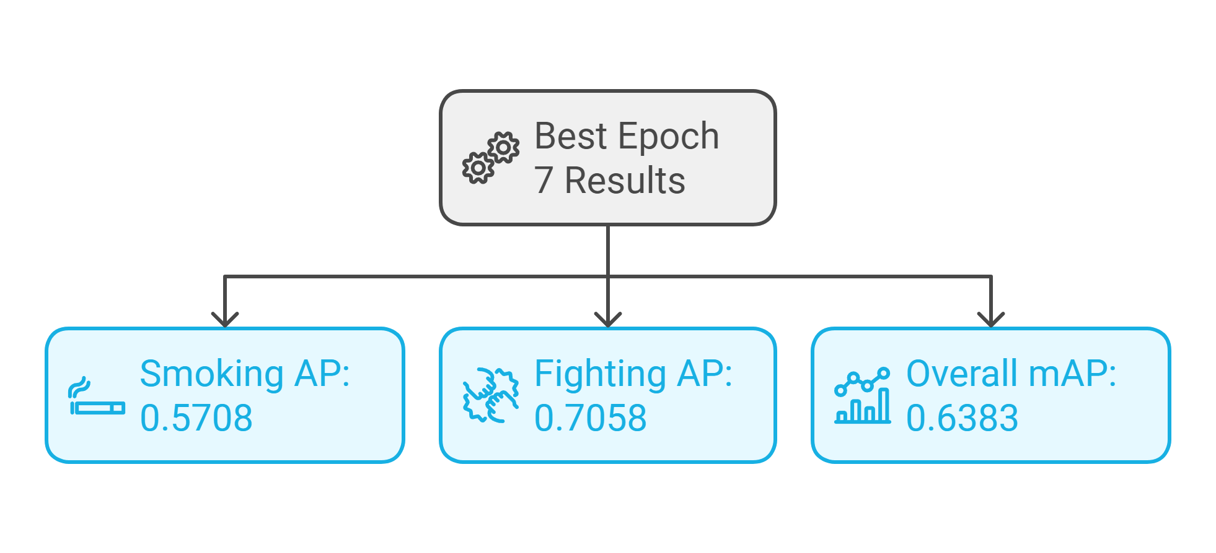
Training Results

Slide 11
Use Case: Detect Behavior

Slide 12
Integrated Video Analysis – Action & Face Detection
Overview & Input Processing
Reads a video stream, extracting frames in sequence.
A human detector (Pre-trained Faster R-CNN by MMdetection) finds people per frame
Frames are buffered to provide temporal context for action detection.
Each person detected gets assigned a unique ID and tracked across frames.
Notes:
We achieved solid performance during training, with validation accuracy peaking at 83%. Reducing the learning rate helped in stabilizing training without causing overfitting.

Slide 13
Integrated Video Analysis – Action & Face Detection
Action & Face Recognition
Fine-tuned model classifies actions (smoking and fighting) based on buffered frames.
When a high-confidence action is found for a certain temporal window, we start gathering that person’s frames.
Cropped face regions based upon bounding boxes are analyzed with face recognition to identify known individuals or label them “Unknown.”

Slide 14
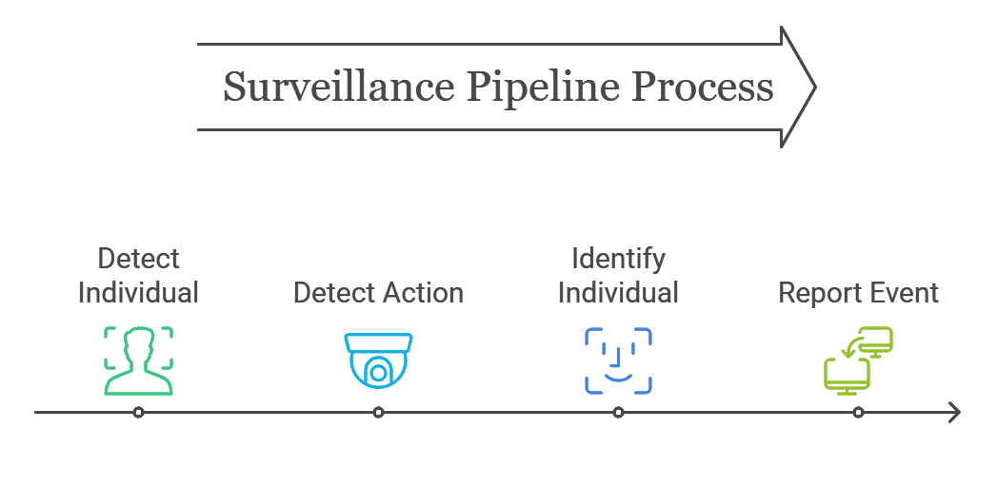
Integrated Video Analysis – Action & Face Detection
Reporting & Storage
Once an action sequence is confirmed, evidence (cropped images) are saved locally.
System sends results and image to a Smart Surveillance Web App server.

Slide 15
Live Demo

Slide 16
Thank You

